Slide 1
COUNTING METHODS (Part 3)
SCSI1013: Discrete Structures
CHAPTER 3
Pigeonhole Principle
nzah@fc.utm.my 2014/2015 – Sem. 1

Slide 2
Introduction
The Pigeonhole Principle is a really simple concept
Discovered in the 1800s
Peter Gustav Lejeune Dirichlet was the youngest member of the Prussian Academy of Sciences, he worked at number theory and analysis
He also came up with a simple little thing that he called The Dirichlet Drawer Principle (or Shoe Box Principle), but that we now call The Pigeonhole Principle.

Slide 3
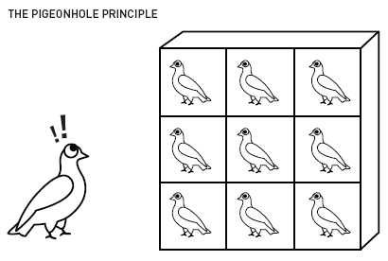
Pigeonhole Principle
Imagine 9 pigeonholes and 10 pigeons. A storm comes along, and all of the pigeons take shelter inside the pigeonholes.
They could be arranged any number of ways. For instance, all 10 pigeons could be inside one hole, and the rest of the holes could be empty.
What we know for sure, no matter what, is that there is at least one hole that contains more than one pigeon.
The principle works no matter what the particular number of pigeons and pigeonholes. As long as there are (N - 1) number of pigeonholes, and (N) number of pigeons, we know there will always be at least two pigeons in one hole.

Slide 4
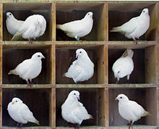
Pigeonhole Principle (1st Form)
Pigeonhole Principle
(First Form)
If n pigeons fly into k pigeonholes and k < n, some pigeonhole contains at least two pigeons

Slide 5
Pigeonhole Principle (1st Form)
The principle tells nothing about how to locate the pigeonhole that contains 2 or more pigeons
It only asserts the existence of a pigeonhole containing 2 or more pigeons
To apply this principle, one must decide
which objects are the pigeons
Which objects are the pigeonholes

Slide 6
Example (PP - 1st Form)
Among 8 people, at least two of them will have been born on the same day of the week.
Pigeonholes : Days (7) – Monday to Sunday
Pigeons: People (8)
Among 13 people there are at least two persons whose month of birth is the same.
Pigeonholes : Months(12) – January to December
Pigeons: People (13)

Slide 7
Example (PP - 1st Form)
In a party there are n people. Prove that there are at least two persons who know exactly the same number of people.
Pigeonholes : How many people a person can know which is at most n-1 (need to exclude him/herself)
Pigeons: People (n)
If a person knows i people then the person is put in the i-th box. There are n people. So there must be one box which contains 2 or more persons.

Slide 8
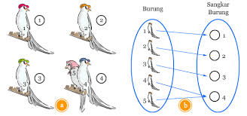
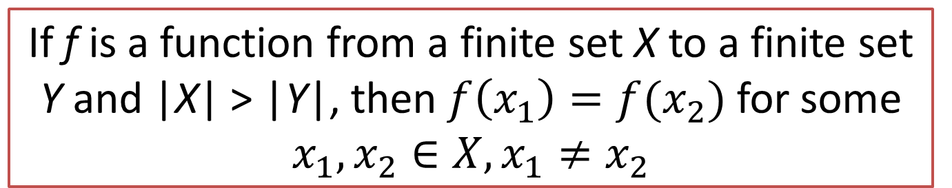
Pigeonhole Principle (2nd Form)
Pigeonhole Principle
(Second Form)
If f is a function from a finite set X to a finite set Y and |X| > |Y|, then $f\left(x_{1}\right)=f(x_{2})$ for some $x_{1},x_{2}∈X,x_{1}≠x_{2}$

Slide 9
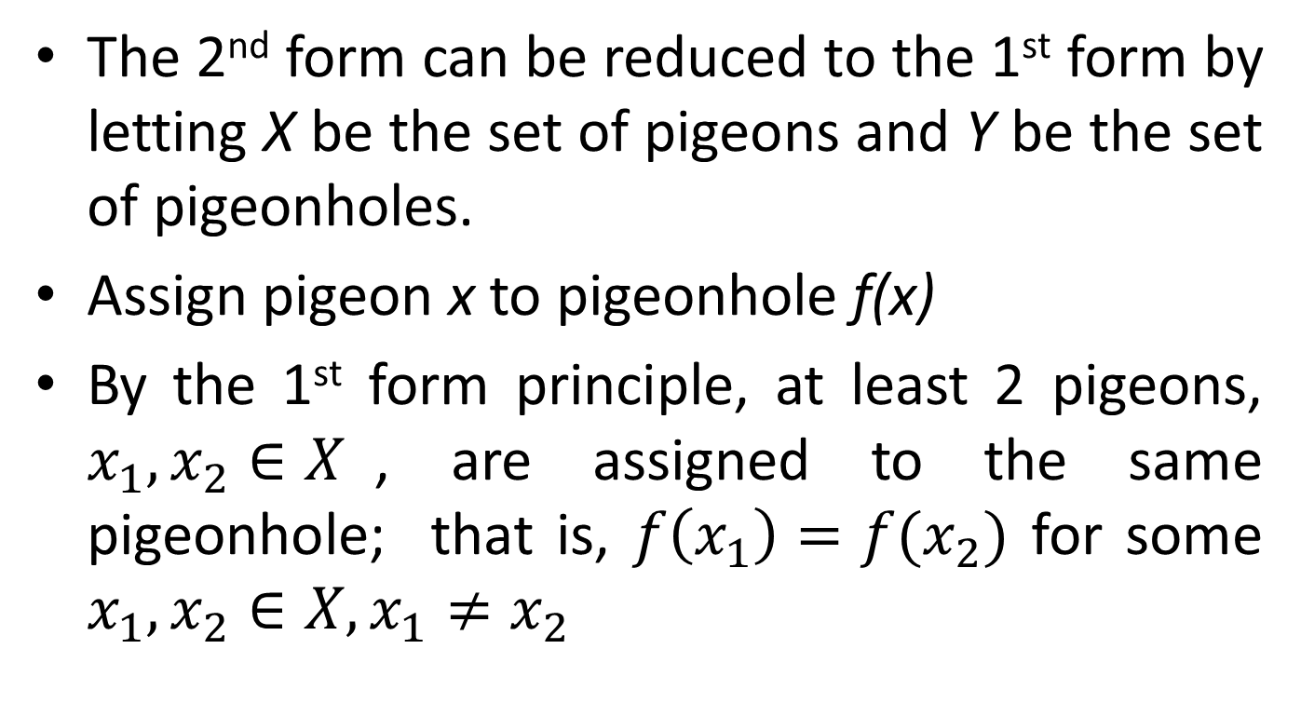
Pigeonhole Principle (2nd Form)
The 2nd form can be reduced to the 1st form by letting X be the set of pigeons and Y be the set of pigeonholes.
Assign pigeon x to pigeonhole f(x)
By the 1st form principle, at least 2 pigeons, $x_{1},x_{2}∈X$, are assigned to the same pigeonhole; that is, $f\left(x_{1}\right)=f(x_{2})$ for some $x_{1},x_{2}∈X,x_{1}≠x_{2}$

Slide 10



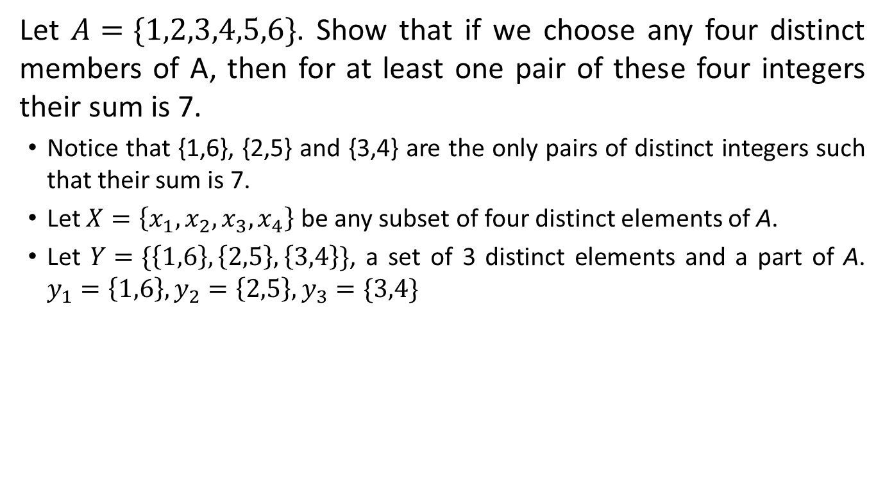




Example 1 (PP – 2nd Form)
Let $A=\{1,2,3,4,5,6\}$. Show that if we choose any four distinct members of A, then for at least one pair of these four integers their sum is 7.
Notice that {1,6}, {2,5} and {3,4} are the only pairs of distinct integers such that their sum is 7.
Let $X=\left\{x_{1},x_{2},x_{3},x_{4}\right\}$ be any subset of four distinct elements of A.
Let $Y=\{\left\{1,6\right\},\left\{2,5\right\},\left\{3,4\right\}\}$, a set of 3 distinct elements and a part of A. $y_{1}=\left\{1,6\right\},y_{2}=\left\{2,5\right\},y_{3}=\{3,4\}$
X
f
Y
$$x_{1}$$
$$\{1,6\}$$
Pigeons
Pigeonholes
$$x_{2}$$
$$\{2,5\}$$
$$x_{3}$$
$$x_{4}$$
$$\{3,4\}$$

Slide 11



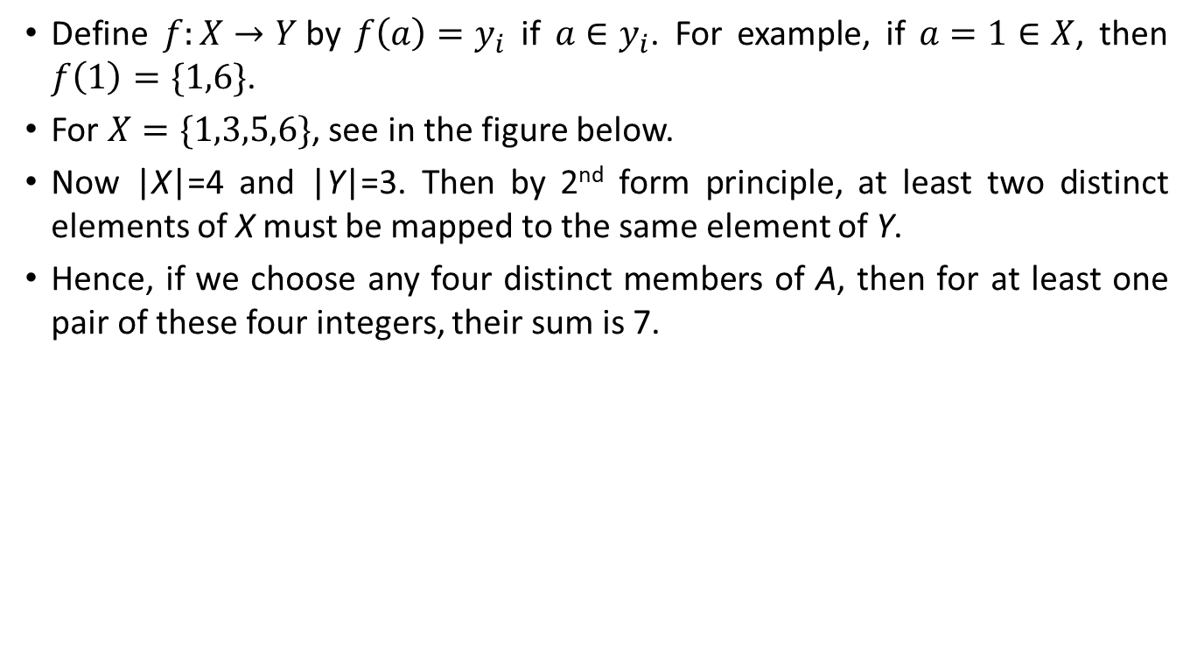




Example 1 (PP – 2nd Form) continue
Define $f:X→Y$by $f\left(a\right)=y_{i}$ if $a∈y_{i}$. For example, if $a=1∈X$, then $f\left(1\right)=\{1,6\}$.
For $X=\{1,3,5,6\}$, see in the figure below.
Now |X|=4 and |Y|=3. Then by 2nd form principle, at least two distinct elements of X must be mapped to the same element of Y.
Hence, if we choose any four distinct members of A, then for at least one pair of these four integers, their sum is 7.
X
f
Y
$$1$$
$$\{1,6\}$$
$$3$$
$$\{2,5\}$$
$$5$$
Pigeonholes
Pigeons
$$6$$
$$\{3,4\}$$

Slide 12
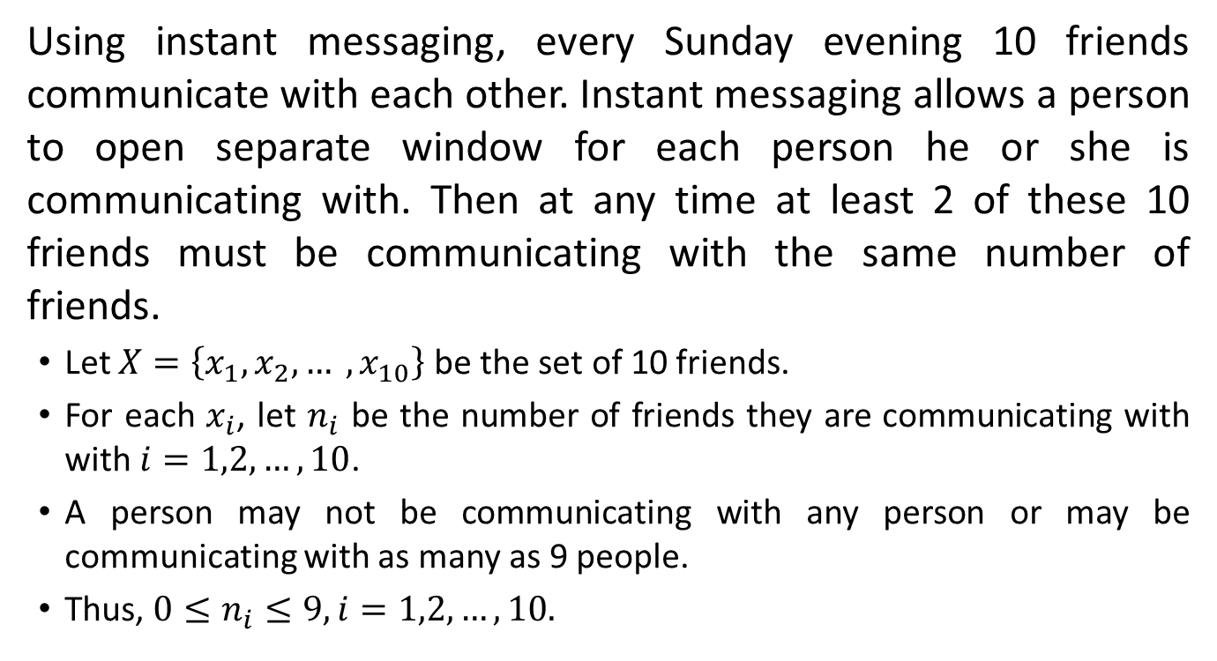
Example 2 (PP – 2nd Form)
Using instant messaging, every Sunday evening 10 friends communicate with each other. Instant messaging allows a person to open separate window for each person he or she is communicating with. Then at any time at least 2 of these 10 friends must be communicating with the same number of friends.
Let $X=\left\{x_{1},x_{2},… ,x_{10}\right\}$ be the set of 10 friends.
For each $x_{i}$, let $n_{i}$ be the number of friends they are communicating with with $i=1,2, …,10$.
A person may not be communicating with any person or may be communicating with as many as 9 people.
Thus, $0≤n_{i}≤9,i=1,2,…,10.$

Slide 13
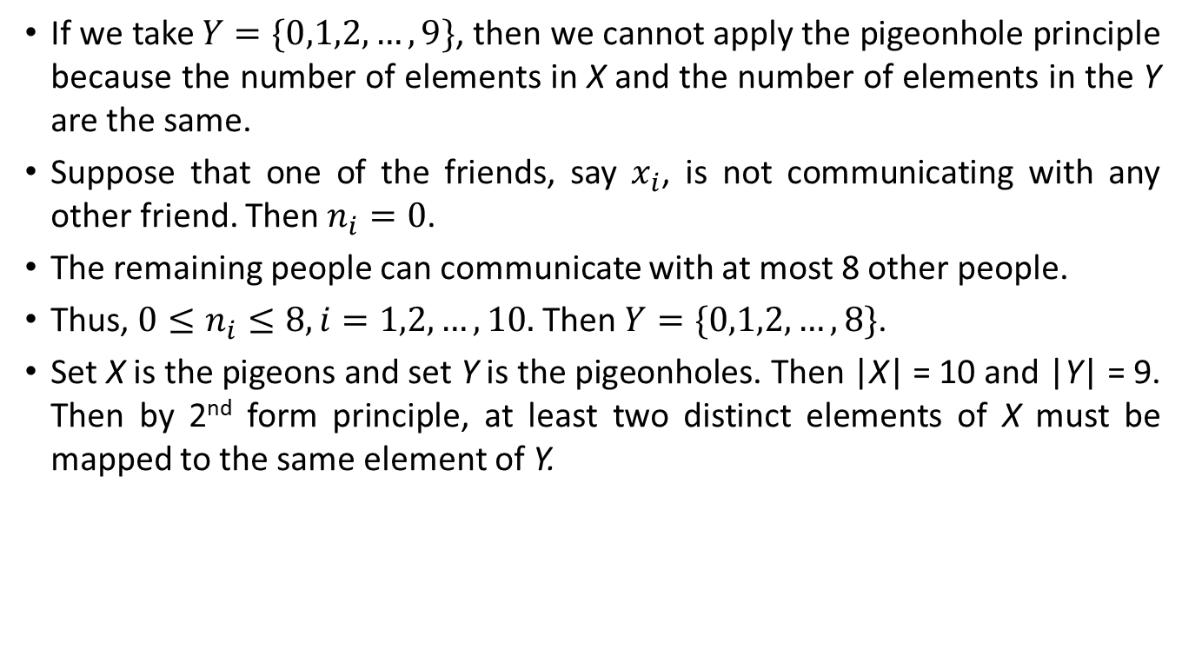
Example 2 (PP – 2nd Form) continue
If we take $Y=\{0,1,2,…,9\}$, then we cannot apply the pigeonhole principle because the number of elements in X and the number of elements in the Y are the same.
Suppose that one of the friends, say $x_{i}$, is not communicating with any other friend. Then $n_{i}=0$.
The remaining people can communicate with at most 8 other people.
Thus, $0≤n_{i}≤8,i=1,2,…,10.$ Then $Y=\{0,1,2,…,8\}$.
Set X is the pigeons and set Y is the pigeonholes. Then |X| = 10 and |Y| = 9. Then by 2nd form principle, at least two distinct elements of X must be mapped to the same element of Y.

Slide 14
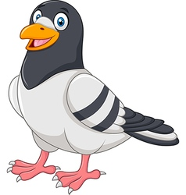
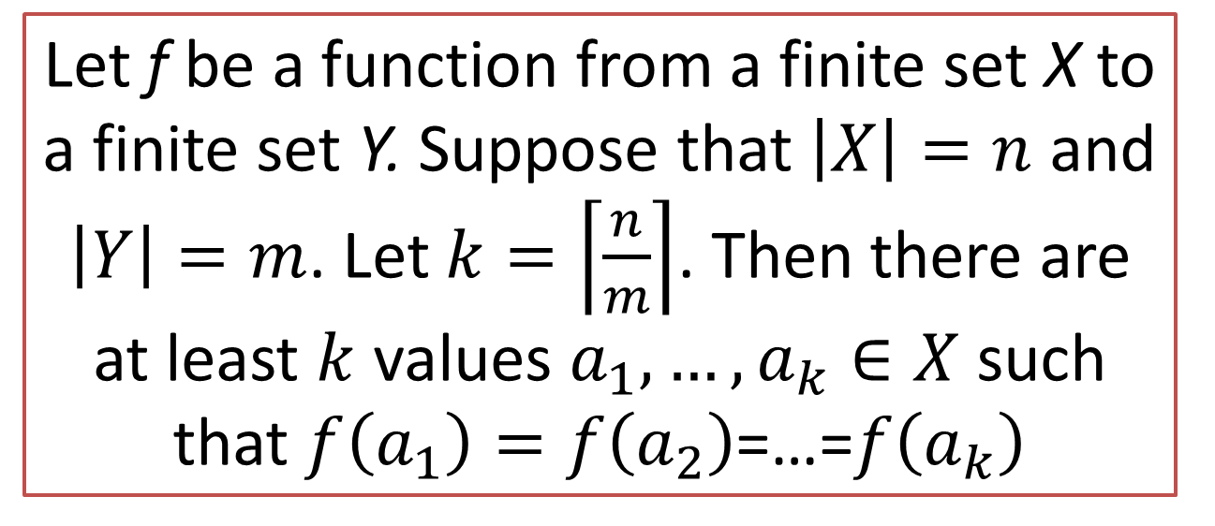
Pigeonhole Principle (3rd Form)
Pigeonhole Principle
(Third Form)
The Generalized Pigeonhole Principle
Ceiling function that takes as input a real number x and gives as output the least integer ceiling (x) = ⌈x⌉ that is greater than or equal to x
Let f be a function from a finite set X to a finite set Y. Suppose that $\left|X\right|=n$ and $\left|Y\right|=m$. Let $k=\left\lceil \frac{n}{m}\right\rceil$. Then there are at least $k$ values $a_{1},…,a_{k}∈X$ such that $f\left(a_{1}\right)=f\left(a_{2}\right)$=…=$f\left(a_{k}\right)$

Slide 15
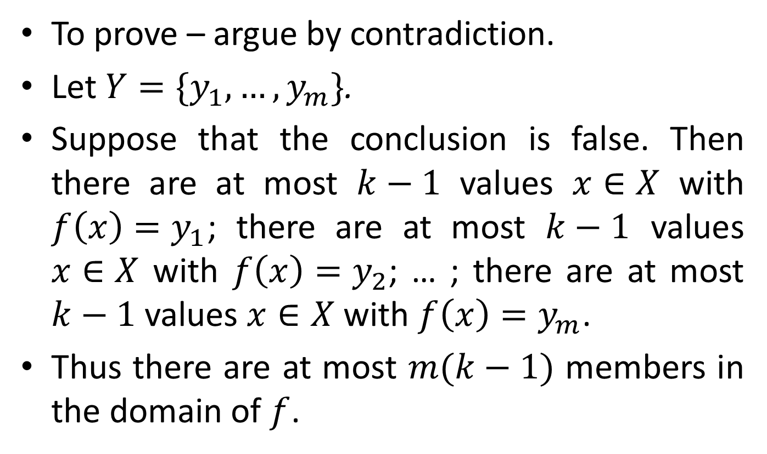
Pigeonhole Principle (3rd Form)
To prove – argue by contradiction.
Let $Y=\{y_{1},…,y_{m}\}$.
Suppose that the conclusion is false. Then there are at most $k−1$ values $x∈X$ with $f\left(x\right)=y_{1}$; there are at most $k−1$ values $x∈X$ with $f\left(x\right)=y_{2}$; … ; there are at most $k−1$ values $x∈X$ with $f\left(x\right)=y_{m}$.
Thus there are at most $m(k−1)$ members in the domain of $f$.

Slide 16
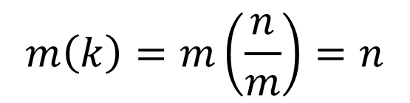
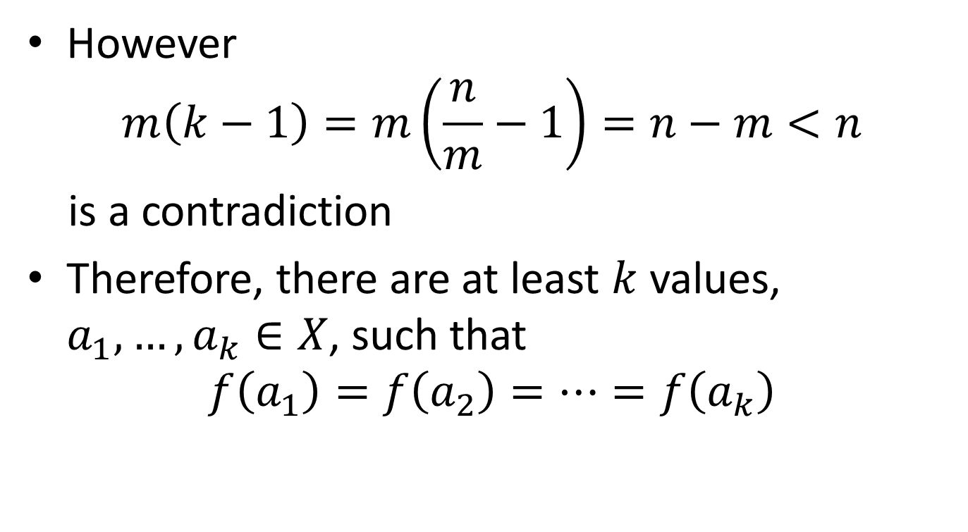
Pigeonhole Principle (3rd Form)
However
$$m\left(k−1\right)=m\left(\frac{n}{m}−1\right)=n−m<n$$
is a contradiction
Therefore, there are at least $k$ values, $a_{1},…,a_{k}∈X$, such that
$$f\left(a_{1}\right)=f\left(a_{2}\right)=…=f\left(a_{k}\right)$$
$$m\left(k\right)=m\left(\frac{n}{m}\right)=n$$

Slide 17
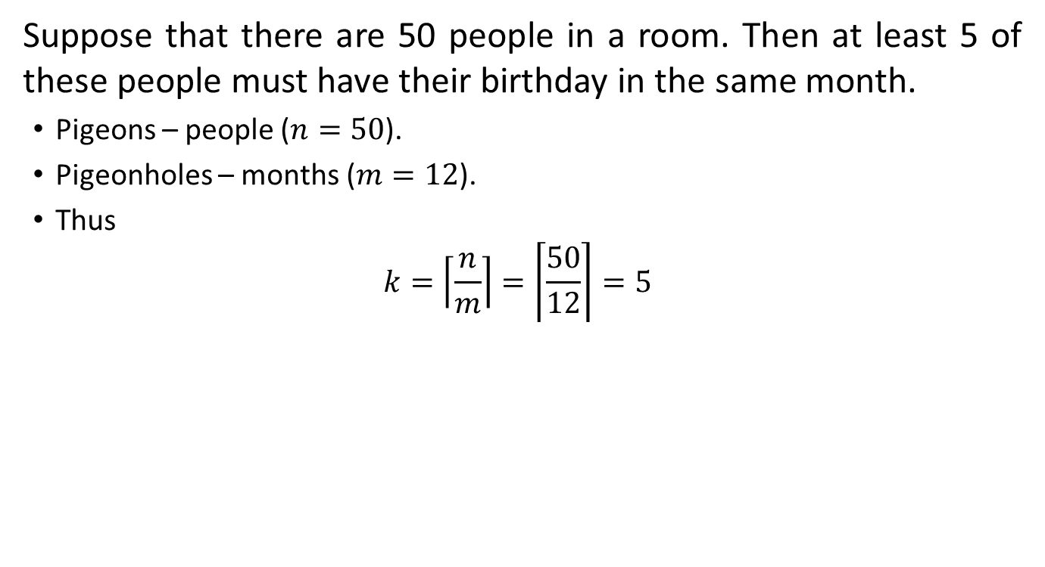
Example 1 (PP – 3rd Form)
Suppose that there are 50 people in a room. Then at least 5 of these people must have their birthday in the same month.
Pigeons – people ($n=50$).
Pigeonholes – months ($m=12$).
Thus
$$k=\left\lceil \frac{n}{m}\right\rceil =\left\lceil \frac{50}{12}\right\rceil =5$$

Slide 18



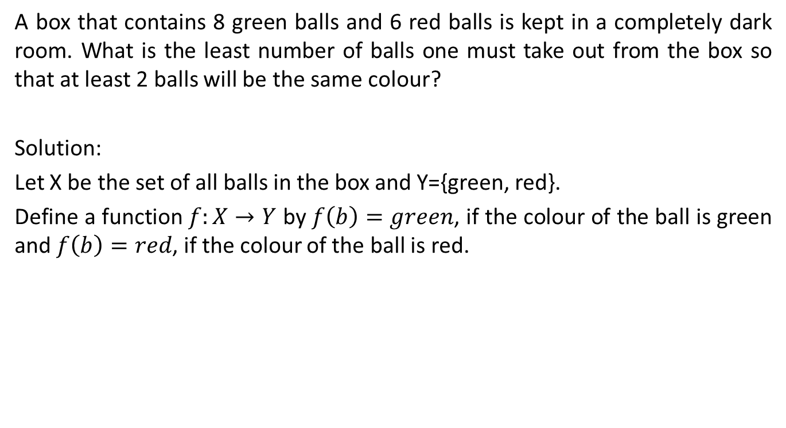



More Examples on Pigeonhole
A box that contains 8 green balls and 6 red balls is kept in a completely dark room. What is the least number of balls one must take out from the box so that at least 2 balls will be the same colour?
Solution:
Let X be the set of all balls in the box and Y={green, red}.
Define a function $f:X→Y$ by $f\left(b\right)=green$, if the colour of the ball is green and $f\left(b\right)=red$, if the colour of the ball is red.
X
f
Y
b₁
$$\text{b}\text{2}$$
$green$
$$⋮$$
Pigeonholes
Pigeons
$$\text{b}\text{1}\text{3}$$
$red$
$$\text{b}\text{1}\text{4}$$

Slide 19

More Examples on Pigeonhole continue
Solution:
If we take subset A of 3 balls of X, then $\left|A\right|>\left|Y\right|$
By the pigeonhole principle, at least two elements of A must be assigned the same value in Y
Therefore, at least 2 of the balls of A must have the same colour
X
f
Y
b₁
$$\text{b}\text{2}$$
$green$
$$⋮$$
Pigeonholes
Pigeons
$$\text{b}\text{1}\text{3}$$
$red$
$$\text{b}\text{1}\text{4}$$

Slide 20
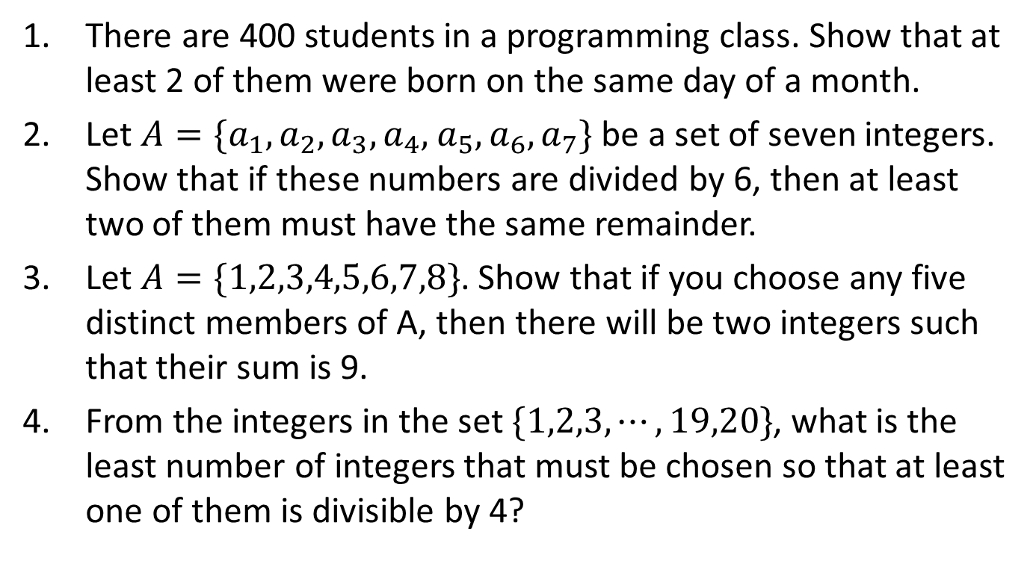
Exercise
There are 400 students in a programming class. Show that at least 2 of them were born on the same day of a month.
Let $A=\{a_{1},a_{2},a_{3},a_{4},$ $a_{5},a_{6},a_{7}\}$ be a set of seven integers. Show that if these numbers are divided by 6, then at least two of them must have the same remainder.
Let $A=\{1,2,3,4,5,6,7,8\}$. Show that if you choose any five distinct members of A, then there will be two integers such that their sum is 9.
From the integers in the set $\{1,2,3,⋯,19,20\}$, what is the least number of integers that must be chosen so that at least one of them is divisible by 4?

Slide 21
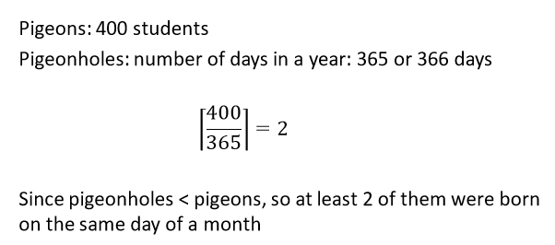
Exercise
There are 400 students in a programming class. Show that at least 2 of them were born on the same day of a month.

Slide 22
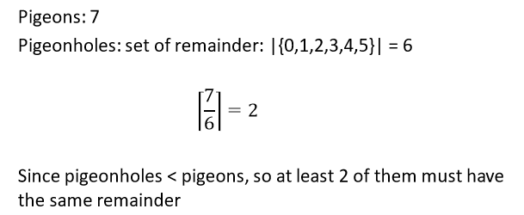

Exercise
2. Let $A=\{a_{1},a_{2},a_{3},a_{4},$ $a_{5},a_{6},a_{7}\}$ be a set of seven integers. Show that if these numbers are divided by 6, then at least two of them must have the same remainder.

Slide 23
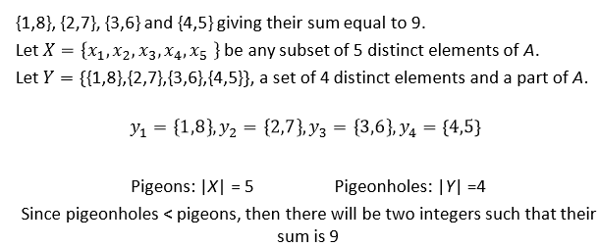

Exercise
3. Let $A=\{1,2,3,4,5,6,7,8\}$. Show that if you choose any five distinct members of A, then there will be two integers such that their sum is 9.

Slide 24
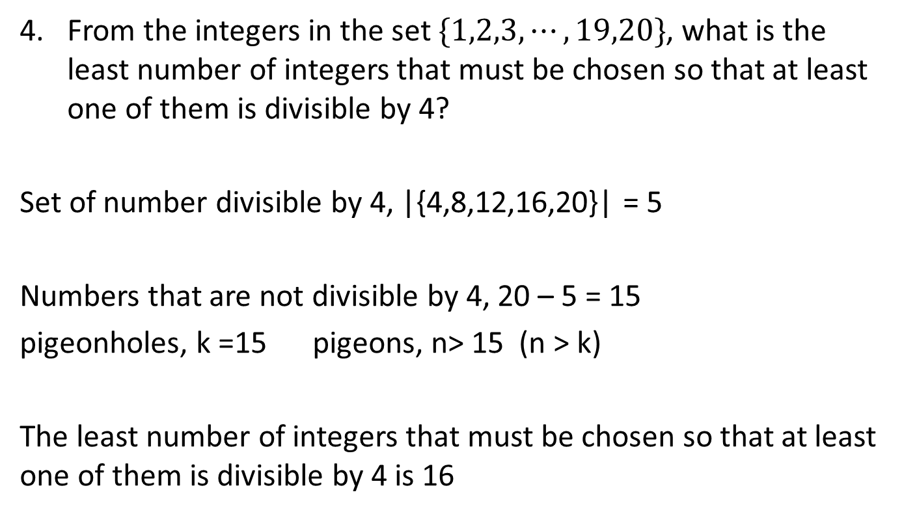
Exercise
4. From the integers in the set $\{1,2,3,⋯,19,20\}$, what is the least number of integers that must be chosen so that at least one of them is divisible by 4?
Set of number divisible by 4, |{4,8,12,16,20}| = 5
Numbers that are not divisible by 4, 20 – 5 = 15
pigeonholes, k =15 pigeons, n> 15 (n > k)
The least number of integers that must be chosen so that at least one of them is divisible by 4 is 16

